Slide 1
Microsoft CISO Workshop 2 – Security Management
Microsoft Cybersecurity Solutions Group
Notes:
© Copyright Microsoft Corporation. All rights reserved. Microsoft, Windows, and other product names are or may be registered trademarks and/or trademarks in the U.S. and/or other countries. The information herein is for informational purposes only and represents the current view of Microsoft Corporation as of the date of this presentation. MICROSOFT MAKES NO WARRANTIES, EXPRESS, IMPLIED OR STATUTORY, AS TO THE INFORMATION IN THIS PRESENTATION.

Slide 2
Microsoft CISO workshop
Lunch
Your strategy
Security management learnings and principles
Kickoff and introduction
Identity and access management
Threat protection
(A) Identify-Protect
(B) Detect-Respond-Recover
Security Management
Vulnerability Management
Compliance and Policy Monitoring/Enforcement
Legal/Compliance Officer
Information protection
Joint planning
CISO WORKSHOP OBJECTIVE: Learn how Microsoft can help you achieve your cybersecurity goals
Notes:
Key Takeaway: This is the Threat Protection module of a full day workshop designed for both your organization and Microsoft to learn where Microsoft can help you achieve your cybersecurity goals.
This module will focus the trends, challenges, and recommended strategy for threat protection (including how Microsoft’s capabilities and guidance map into that strategy)

Slide 3
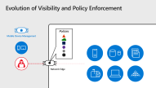
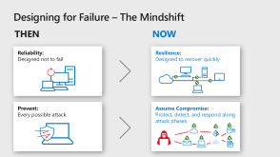
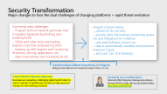
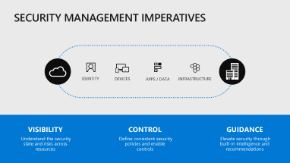
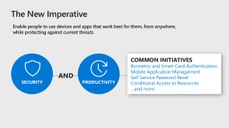
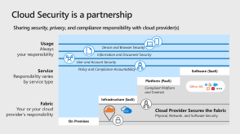
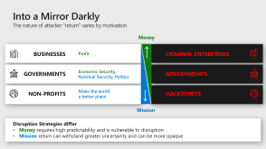
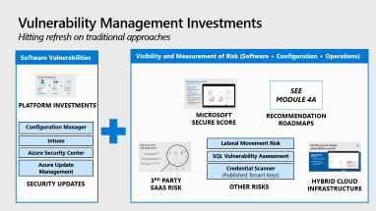



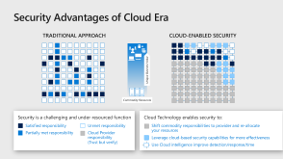
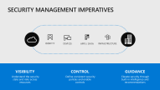

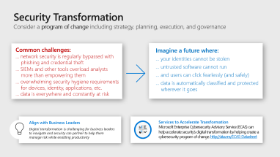
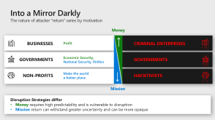

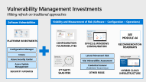
Overall Principles + Security Management Strategy
Key Principles
RUIN ATTACKER ROI
PRODUCTIVITY AND SECURITY
Assume Compromise
Shared Responsibility
CLOUD IS MORE SECURE
Security Management
Success Criteria & Use Cases
Visibility, Control, & Guidance
Vulnerability Management
Security Transformation
Notes:
Key Takeaway: This is the module layout.
This slide uses the PowerPoint zoom feature, you can present it and click on each section to skip to it

Slide 4
Into a Mirror Darkly The nature of attacker “return” varies by motivation
Money
BUSINESSES
GOVERNMENTS
NON-PROFITS
Profit
CRIMINAL ENTERPRISES
GOVERNMENTS
HACKTIVISTS
Economic Security, National Security, Politics
Make the world a better place
Mission
Disruption Strategies differ
Money requires high predictability and is vulnerable to disruption
Mission return can withstand greater uncertainty and can be more opaque
Notes:
Key Takeaway: Strategies to disrupt attackers vary based on their motivation (though it is often difficult to ascertain the identity and motivations of attackers)
Legitimate organizations are typically motivated by money and/or pursuing and accomplishing a mission (the nature of which can vary significantly)
CLICK 1
The motivations of attackers typically fall along a similar spectrum of profit and mission goals. This is important for defenders understand because it can inform your defense strategies
Money – Like legitimate businesses, profit driven attackers require return on investment as well as predictability of return.
Mission – These attackers are less susceptible to uncertainty of return, but you can still impact their ability to achieve their mission and the cost to do so.

Slide 5
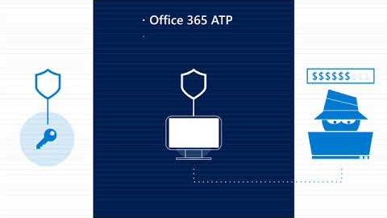
Disrupt Attacker ROI Prioritize investments to maximize impact
Rapid detection and response drives down predictability and quantity of return
https://youtu.be/maQh35MdFKY
Attacker Return: Successful Monetization
Defender Return:
Ruin Attacker ROI
Deters opportunistic attacks
Slows or stops determined attacks
Security Return on Investment (SROI)
Attacker Investment: Increase Attack Friction & Cost
Defender Investment:
Security budget
Team time/attention
Prioritizing defense can rapidly raise impact attacker cost & friction
Cost of Attack Video
https://youtu.be/maQh35MdFKY
Notes:
Key Takeaway – Defenders should measure success by how much they have raised the cost attacks for attackers
While important for planning, Security Return on Investment (SROI) is difficult to calculate precisely because both components of risk are clouded with uncertainty
Impact: Many business outcomes are unknown and difficult to measure (e.g. impact of reputational damage, impact to bottom line if competitive products benefitted from stolen designs, etc.)
Likelihood: Many key factors fluctuate in the short term (Attack operators are adaptive humans, attack techniques/tools/business models constantly evolve, etc.) and we don’t have sufficient detailed/accurate records for calculating probability over time like with car accidents, hurricanes, or life expectancy.
CLICK 1
Defender Investment is composed of
Security budget for purchasing technology and hiring/rewarding people
The time and attention of the team members you have hired
CLICK 2
Defender Return is composed of your ability to
Reduce the attacker's ROI which has the effect of
Discouraging opportunistic attackers who will move on to another target that is easier to attack
Reducing the frequency/success of determined adversaries who are targeting your organization specifically
Reduce the business impact of any attack on your organization
CLICK 3
Attacker ROI is an important factor that defenders must work to influence
Attacker Return is largely out of the influence/control of individual defenders (e.g. black market availability, law enforcement effectiveness, etc.), but you can impact this with rapid response and recovery that deprives attackers of time to access your resources and achieve their objectives. This will reduce attacker return and the predictability of their return, making you a less attractive target.
Attacker Investment is the best opportunity for a defender to influence success. By adopting a strategy that is focused on defeating the cheapest attack mechanisms first, you can force an attacker to increase investment of money/time/resources and lower their ROI.

Slide 6
Ruin Their ROI Changing the economics of cybersecurity
ATTACKERS: MAXIMIZE RETURN ON INVESTMENT (ROI) (return may be monetary/political/etc.)
DEFENDERS: RUIN ATTACKER ROI by raising attack cost with protection + rapid response/recovery
MICROSOFT: SIMPLIFY ADVANCED CAPABILITIES across platforms, clouds, and IoT
COST OF ATTACK
NATION STATE
SIMPLIFICATION
INTEGRATION
INTELLIGENCE
DEFENDER BUDGET
ORGANIZED CRIME
AMATEUR
ATTACKER RESOURCE LEVELS VARY
NOTE: Cost of attack is continuously changing with technical advancement + business model evolution
Notes:
Key Takeaway – A defender’s budget should be focused on raising cost of attack
Various types of attackers have different thresholds of cost of attack that they can withstand in the pursuit of their objectives (mission and money driven alike)
CLICK 1
A defender’s budget should raise the cost of attack for all types of attackers that may be targeting the organization (or affect it with commodity attacks)
CLICK 2
Microsoft is focusing on simplifying the application and integration of advanced security techniques so that many organizations can benefit from these capabilities and help increase attacker cost.

Slide 7

Rapidly Raising Attacker Cost
Change the Defender’s Dilemma to an Attacker’s Dilemma
RUIN ATTACKER’S ECONOMIC MODEL
BREAK THE KNOWN ATTACK PLAYBOOK
RAPID RESPONSE AND RECOVERY
ELIMINATE OTHER ATTACK VECTORS
Notes:
Key Takeaway – Defenders should be focusing on ruining the attacker's model by raising the cost of attack.
This is designed to shift the current
“Defenders dilemma” – one mistake in your defenses and the adversary will be successful anyways, sending defenders ‘back to the drawing board’
To an
“Attackers Dilemma” – one mistake in your attack campaign will undo the hard work put into the attack - planning, researching, finding/purchasing vulnerabilities, etc. and send the attackers ‘back to the drawing board’
CLICK 1
You should block the cheapest path to techniques first. These are attack techniques that have been used against you, your industry peers in others in industry.
Blocking these will rapidly raise the cost to attack your environment
CLICK 2
You need good detection and response processes/capabilities to limit the time and freedom of attackers to conduct attacks while on your environment and to explore while they are there.
These capabilities will also quickly raise the cost to attack your environment
CLICK 3
Other investments should default to a lower priority than known attacks and detection/response. Once you have solid detection/response in place and key defenses against known attacks, your investments can start shifting toward potential and future attacks, but this is not a luxury most organizations can afford in their security budget or as an acceptable risk.

Slide 8
Cost of Attack Examples
Attack techniques observed in your environment
High likelihood of use
Attack kits and Malware as a Service
Freely available tools/techniques (credential theft, exploits in Metasploit)
Low likelihood of use
Zero day vulnerabilities in common software/protocols
Zero day vulnerabilities in specialized protocols/devices
Low cost
High cost
Note: For-profit attackers generally follow rational economic behavior and favor cheaper/available attacks. Advanced attacks (exceptions) are expected if:
Low cost attacks are mitigated and criminals value assets/objectives sufficient to invest more
Advanced nation state actors target your organization (and already have library of advanced techniques)
Notes:
Key Takeaway: Different techniques are relatively cheap vs. expensive for an attacker
Diving a bit deeper into attack costs, these are the lowest cost attack techniques for attackers that may target you.
Anything an attacker has already used against you is available and has little/no additional cost to use again (no new skills, technology or vulnerability required)
End-to-end attack kits (e.g. ransomware as a service) will likely hit your end users as they are almost fully automated and require very little skills or money, lowering barrier to entry for new attackers.
Freely available tools and well established attack methodologies are also likely to be seen, though it takes more skill to assemble those into an attack campaign than a full service kit.
One thing to consider in your risk calculations is that some attack groups have already developed advanced tools and skills (such as nation states) while others do not.
CLICK 1
Zero days are actually pretty low in the spectrum of risk (impact x likelihood) as they are expensive to discover or purchase (requires expert researcher skills).
We do occasionally see high impact Zero Day events like the MS17-010 (used in WannaCrypt/NotPetya attacks), but these are rare because of the high cost of attackers researching or purchasing zero day vulnerabilities. Every time an attackers uses a zero day, they also face the risk the vulnerability getting “burned” (the vendor discovers it and releases a patch)
Additional Information
Some attack groups already have advanced tools and skills, so incremental cost of using against them against a new target is low.

Slide 9
The New Imperative
Enable people to use devices and apps that work best for them, from anywhere,
while protecting against current threats
SECURITY
PRODUCTIVITY
COMMON INITIATIVES
Biometric and Smart Card Authentication
Mobile Application Management
Self Service Password Reset
Conditional Access to Resources
…and more
AND
OR
Notes:
Key Takeaway: Security must be an enabler of business productivity and digital transformation, not an obstacle.
Many people see security and productivity as a tradeoff (e.g. believe you can have one but not the other)
CLICK 1
Microsoft strongly believes that organizations must strive to be both secure and productive to be successful in this age of user choice and increased threats.
Some examples of how to achieve both include
Biometrics and Virtual Smart Card Authentication – These technologies simultaneously make it easier for users to authenticate (just look at camera, swipe fingerprint, type short PIN, etc.) and increase security by protecting credentials using strong hardware security assurances from Trusted Platform Module (TPM) chips.
Mobile Application Management (MAM) – MAM enables you to manage the security of the productivity applications that come with the devices (as well as premium productivity applications like Microsoft Office). This allows security to have the visibility and control needed to mitigate risk while enabling users to increase productivity using these applications (over the poor user experience of the limited functionality apps provided by many Mobile Device Management (MDM) solutions). Additionally, this discourages users from using completely unmonitored and unsecured applications or devices to maintain their productivity.
Self Service password reset – Providing a streamlined self-service password reset capability (based on multi-factor authentication), organizations can immediately save money over manual processes, increase user satisfaction and productivity, and increase security by having the ability to do larger password resets on demand (as in the case of a security incident).
Conditional Access – Conditional access in Azure Active Directory allows you to set rules on accounts and applications to require security health characteristics of the devices (device managed, device is compliant, device has hardware-level device health attestation [Windows 10 only]) before allowing access. This allows organizations to both increase user choice of devices (don’t care about device as long as device is secure) while increasing the security posture (no access unless device is secure).
Additional Commentary
From a strategic perspective, all information security risks are ultimately business (or mission) risks that must be considered against other organizational risks and opportunities.
Additionally, an overly strict security policy could create more risk than it mitigates. If the policy prevents user productivity, that creates an incentive for users to do anything to get their job done including “Shadow IT” methods that use less secure personal devices and filesharing services for collaboration.

Slide 10

Designing for Failure – The Mindshift
THEN
NOW
Reliability: Designed not to fail
Resilience: Designed to recover quickly
Prevent: Every possible attack
Assume Compromise: Protect, detect, and respond along attack phases
!
!
!
!
!
!
Notes:
Key Takeaway: Like IT has already done, security should shift to an “assume failure” mindset
With the adoption of cloud technology, Information Technology is assuming failure and shifting from a reliability mindset (reduce mean-time-between-failures (MTBF)) to a resilient mindset (reduce mean-time-to-recover (MTTR))
This is exemplified by a resilient cloud service that:
- minimizes the impact of failure on any given customer,
- minimizes the number of customers affected by a failure
- reduces the amount of time customers are prevented from using the service
CLICK 1
Security should adopt a similar assumption in the age of continuous and evolving attacks.
We can no longer block every possible attack at a firewall that stands between our assets and the threats. We must assume compromise and invest in protections and detections at each phase of an attack (aka the kill chain). The overall architecture and each asset in it should be resilient to a compromise.

Slide 11






Cloud Security is a partnership
Sharing security, privacy, and compliance responsibility with cloud provider(s)
Usage
Always your responsibility
Device and Browser Security
Information and Document Security
User and Account Security
Service
Responsibility varies
by service type
Policy and Compliance Accountability
Software (SaaS)
Platform (PaaS)
Compliant Platform and Controls
Office 365
Infrastructure (IaaS)
Fabric
Your or your cloud provider’s responsibility
Cloud Provider Secures the Fabric
Physical, Network, and Software Security
On Premises
Notes:
Key Takeaway: Adopting cloud technologies creates a shared responsibility with the cloud provider on security, privacy, and compliance
Cloud services from a trustworthy provider can offer many significant benefits for IT operations and security (more details on security in the next slide)
Some organizations are familiar with sharing responsibilities along “layer 2” of infrastructure as a services and this is a good basic start to understanding a partnership with a cloud provider.
CLICK 1
Variation – Responsibility is more nuanced as you look at the full spectrum of cloud services including SaaS, PaaS and IaaS. (in grey) The cloud provider provides a platform that meets your security, privacy, and compliance needs. While you must trust them to secure and operate it, you should verify those claims.
CLICK 2
The cloud provider is responsible for the physical, network, and software security of the fabric, even if that includes their usage of another underlying cloud provider (e.g. a SaaS service that is hosted on Azure or Amazon Web Services).
CLICK 3
Many responsibilities remain the responsibility of the cloud tenant/customer. You are responsible for properly securing
The accounts and credentials that access the cloud services (especially the administrative accounts)
The documents and data stored on the cloud service (using controls provided by the cloud provider or separate services like Azure Information Protection)
The devices and browsers used to access the service (whether they are managed by your IT department, your users, or your customers)

Slide 12
Security Advantages of Cloud Era
TRADITIONAL APPROACH
CLOUD-ENABLED SECURITY
Unique Business Value
Commodity Resources
Security is a challenging and under-resourced function
Cloud Technology enables security to:
Satisfied responsibility
Partially met responsibility
Unmet responsibility
Shift commodity responsibilities to provider and re-allocate your resources
Leverage cloud-based security capabilities for more effectiveness
Use Cloud intelligence to improve detection/response time
Cloud Provider responsibility (Trust but verify)
Notes:
Key Takeaway: The cloud offers significant advantages for solving longstanding information security challenges
We will be comparing a traditional security approach to a cloud enabled approach
When we look at the technology stack, there is a spectrum of assets ranging from commodity assets with low intrinsic value to the organization (like storage and computing) all the way up to assets with unique value to the organization like data, user accounts, and (to a lesser degree) devices and applications.
CLICK 1
Security is a difficult occupation because we never have enough resources to fully secure all assets. It’s a “100 gallon” problem and we only have 10-15 gallons to solve it with (perhaps 20-25 gallons if you are a well funded bank ☺)
This means there are many security projects in the backlog state and many unmet security responsibilities from, representing accepted risk (whether or not the risk is understood or acknowledged).
Attackers aren’t picky and they can reach their objectives using any technique that is effective, ranging from exploiting unpatched firmware/OS/App/etc. to technical configuration weaknesses to human errors by users or administrators.
CLICK 2
The first advantage of the cloud is that it allows you to transfer day to day responsibility for many layers of the stack (varies by SaaS/PaaS/IaaS) to the cloud provider. While you have to invest time and effort to verify the trustworthiness of a provider, once you find a trustworthy one, it’s to your benefit to transfer as much security and operational responsibility to them. Shedding those responsibilities allows you to focus your team and budget on other parts of security (like the often delayed information protection project that many organizations have has in their long term plans for a long time ☺)
CLICK 3
The constant connectivity and resource tracking improvements of cloud technologies allow security to do more with less resources. Some examples include
Documents can “phone home” for better protection and monitoring – Azure Information Protection takes advantage of the high connectivity of cloud services to protect documents by persisting encryption wherever they go, but requiring them to connect to the cloud service for access to the keys (the caching of which is governed by your policy and monitored)
Increase coverage for hygiene and protections – because resources on a software defined datacenter like Azure are tracked closely and consistently, technology like Azure Security Center can provide complete coverage for assets in your tenant, avoiding the perpetual problem of “losing” or “finding” servers in physical datacenters. This complete coverage makes it easier to get to high confidence in security hygienge when you use a tool Azure Security Center offers to identify vulnerabilities like missing software updates, antimalware, web application firewall, and variations from desired configuration baselines.
Better business impact analysis– You can use a Cloud App Security Broker (CASB) like Microsoft Cloud App Security (MCAS) to analyze Office 365 logs and quickly assess potential or actual business impact of an attack (e.g. what documents did an account access during the period it was compromised by an adversary) vs. the manual and inconsistent process of many on-premises organizations.
CLICK 4
Threat Detection in the cloud can take advantage of the massive capacity of the cloud to store and process massive amount of events and other threat signals to improve detection by separating the signal from the noise using context and machine learning.
Additionally, the cloud offers the community effect – if 100 customers are protect by cloud threat detection, an investigation of a new technique/etc. on one benefits the other 99 with little/no effort on their part.
An example is the alerts in Azure Security Center that are regularly updated by the product team vs. the manual static rule creation of a classic SIEM approach)
Additional Commentary
In addition, large public cloud service providers such as Microsoft can invest billions of dollars so that they can get the optimal mix of people, processes and technologies to attack security issues head-on. In contrast to on-premises computing, Microsoft cloud services are able to detect and respond in almost real time because we have continuous access to security event information across millions of devices with many millions of network connections and logging activities. Behavioral analysis, anomaly detection and sophisticated statistical algorithms are used and continuously updated to help identity potential compromise as it happens.

Slide 13
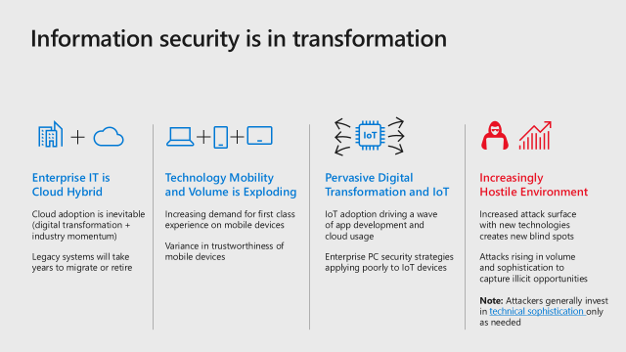
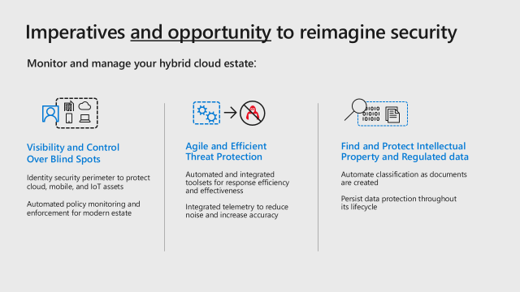
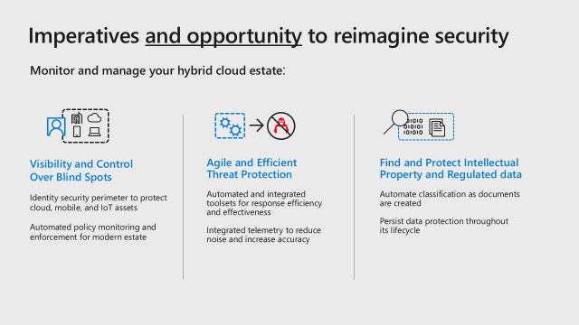

Imperatives and Opportunities
Recognize Fundamental Transformations
Meet Challenges + Embrace Opportunities
DRIVE STRATEGIC OUTCOMES
Security Management
Identity and Access Management
Information Protection
Threat Protection
Gain end-to-end visibility into your organization’s security and manage security policy centrally
Ensure only the right people have access to your organizational systems
Protect documents, databases, and emails against leaks, tampering, and destruction
Thwart hackers and recover quickly if attacked
Notes:
Key takeaway: Across our platform, we look at security across identity and access management, threat protection, information protection and security management. Having a holistic approach to securing these areas improves your security posture.
Microsoft works with many CISOs across industries and consistently finds that these are top priorities for our customers.
The CISO workshop covers our learnings and recommended strategies for each of these areas:
Security Management – Increase visibility and control over your hybrid technology estate with integrated guidance and automated policy enforcement and monitoring.
Identity and Access Management – Helping you build a new security perimeter our of network controls protect new asset types outside your corporate network as well as better protect existing assets within your corporate network
Information protection – Protect sensitive information in your organization with automatic classification, persistent protection, and persistent monitoring of data anywhere it goes (mobile devices, cloud services, USB sticks, corporate assets, etc.)
Threat Protection – Modern protections and detection designed to raise attacker cost, many of which are powered by the trillions of signals in our intelligent security graph

Slide 14
Information security is in transformation
IoT
Enterprise IT is Cloud Hybrid
Cloud adoption is inevitable (digital transformation + industry momentum)
Legacy systems will take years to migrate or retire
Technology Mobility and Volume is Exploding
Increasing demand for first class experience on mobile devices
Variance in trustworthiness of mobile devices
Pervasive Digital Transformation and IoT
IoT adoption driving a wave of app development and cloud usage
Enterprise PC security strategies applying poorly to IoT devices
Increasingly Hostile Environment
Increased attack surface with new technologies creates new blind spots
Attacks rising in volume and sophistication to capture illicit opportunities Note: Attackers generally invest in technical sophistication only as needed
Notes:
Key Takeaway: Microsoft is seeing major transformation of almost all aspects of IT and information security
Information Security departments are operating in a world that has changed vastly since the current generation of security best practices were established.
Several key trends stand out:
1. Enterprise IT is Cloud Hybrid
Enterprise computing is a hybrid of on-premises and cloud at most organizations we work with. This hybrid approach is being primarily driven by the attractiveness of the cloud technology value proposition and the challenges of fully shutting down the last legacy on-premises technology.
CLICK 1
2. Technology Mobility and Volume is Exploding
The growth of mobile devices will continue as will the demand for a first-class experience with the native applications (vs. the limited functionality of most MDM solutions). Enterprises will also have to start managing the variance in trustworthiness of these devices to better balance risk and productivity.
CLICK 2
3. Pervasive Digital Transformation and IoT
Businesses will be digitally transforming to compete with cloud-native startups that are trying to disrupt existing industries/markets they operate in. This will drive
Increased Internet of Things (IoT) device usage
Cloud service adoption for storage, processing, analytics, blockchain, etc. to support them
The IoT space will create challenges around
New ways of managing device risk (as PC risk strategies don’t work for many/most IoT devices)
Application development security (as custom/bespoke code will be required to support new models)
CLICK 3
4. Increasingly Hostile Environment
Both the attack surface of the modern enterprise and the threat volume and sophistication are continuing to rise.
We have observed that attackers tend to follow rational behavior and most attackers favor the simplest and cheapest means to achieve their goals (even sophisticated attackers with access to advanced tools sometimes choose to use off the shelf tools). Much like the famous California gold rush of 1849 where many fortunes were made selling clothing and tools to miners and prospectors, specialized suppliers are springing up to support the massive growth of the cybercrime economy. This is lowering the cost for new entrants and is also allowing the advanced players to specialize further and increase sophistication.

Slide 15
Imperatives and opportunity to reimagine security
Monitor and manage your hybrid cloud estate:
Visibility and Control Over Blind Spots
Identity security perimeter to protect cloud, mobile, and IoT assets
Automated policy monitoring and enforcement for modern estate
Agile and Efficient Threat Protection
Automated and integrated toolsets for response efficiency and effectiveness
Integrated telemetry to reduce noise and increase accuracy
Find and Protect Intellectual Property and Regulated data
Automate classification as documents are created
Persist data protection throughout its lifecycle
Notes:
Key Takeaway – While challenging, this cloud age represents an unprecedented opportunity for information security.
Information security can take a fresh approach to solving new and old security problems as well to build and improve relationships with business functions and leaders.
Monitoring and managing a hybrid of cloud/digital and on-premises legacy assets requires
1. Visibility and control over blind spots in this estate
An identity based security perimeter (we will cover more in module 3)
Automating policy monitoring and enforcement to improve your security management (we will cover more in module 2)
CLICK 1
2. Agile and Efficient Threat Protection
As threats grow, so does signal volume and the difficulty to process them fast enough.
You should increase the efficiency and agility of how you prevent, detect, and respond to threats using the limited available resources you have. Modern preventive controls, automation, and integrated tools/telemetry can radically change your effectiveness here.
CLICK 2
3. Find and Protect Intellectual Property & Regulated Data
Information protection is critical in the age of sophisticated threats and the massive variety of devices, applications and services where data can travel.
It is critical to be able to apply security protections directly to the data itself (vs. the containers it happens to be stored in at the moment)

Slide 16
SECURITY MANAGEMENT IMPERATIVES
IDENTITY
DEVICES
APPS / DATA
INFRASTRUCTURE
VISIBILITY
CONTROL
GUIDANCE
Understand the security state and risks across resources
Define consistent security policies and enable controls
Elevate security through built-in intelligence and recommendations
Notes:
Key Takeaway: Across these 4 core components of any modern enterprise, an effective security management solution should provide 3 key tenets; Visibility, Control and Guidance.
An effective security management solution should provide 3 key tenets:
- Full visibility that helps you understand the security state and risks across resources;
Built-in security controls to help you define consistent security policies;
Effective guidance to help elevate your security through actionable intelligence and recommendations.

Slide 17
Top Security Management Use Cases VISIBILITY – CONTROL – GUIDANCE
Asset/Vulnerability/Risk Management and Reporting
Visibility and control over cloud, mobile, and IoT resources
Assess, remediate, and report risk from vulnerabilities
Regulatory Compliance Management
Assess and Manage compliance risk across cloud assets
Meet new regulatory needs (primarily from General Data Protection Regulation (GDPR))
Shorter data breach reporting deadline (within 72 hours)
Outcomes of information security and privacy controls (vs. control adherence)

Slide 18




Asset/Vulnerability/Risk Management and Reporting
Visibility and control over cloud, mobile, and IoT resources
Assess, remediate, and report risk from vulnerabilities
Visibility and control of MODERN ESTATE
VULNERABILITY MANAGEMENT

Slide 19

Evolution of Visibility and Policy Enforcement
Policies
Mobile Device Management
Network Edge
Notes:
Key Takeaway: Traditional security strategies once seemed simple and effective, but really don’t achieve either one anymore.
When all the resources on a single network, implementing a single control point at the network edge blocked many attack types and seemed like a simple and effective solution.
CLICK 1
Over time we learned that:
This simplicity broke down quickly fast when it took thousands of rules to try and express policy for applications, identities, and hosts using IP addresses and ports.
The effectiveness of the strategy broke down with the rise of phishing emails and credential theft attacks
CLICK 2
The adoption of mobile devices outside the firewall was the first forcing function to adopt a new type of policy engine that was tailored to the asset -- Mobile device management (MDM)
While there were (and are) still some challenges with MDM’s user experience, the policy expression and enforcement was clear, comprehensible, and manageable by stakeholders (unlike a firewall ruleset)

Slide 20



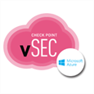

Evolution of Visibility and Policy Enforcement
Azure Security Center
Azure Information Protection (AIP)
Microsoft Intune MDM/MAM
Cloud App Security
Azure Policy
Office 365 DLP
Mobile Device Management
Cloud App Security Broker
Infrastructure
Information Protection
Office 365
Security and Compliance
Threat Intelligence
Security Appliances
Network Firewall
Endpoint
Identity
Windows Security Center
Conditional Access
As assets leave the single managed network, use policy controls focused on managing them
Notes:
Key Takeaway: Modern security strategies require controls tailored to each asset, allowing for simpler and more manageable policy definition and execution.
As the world outside the firewall grows, security management must continue to evolve with policy engines tailored for each asset, monitoring and managing with policies that are simple and straightforward to human stakeholders. The centralized policy engine for assets managed in this way now shifts from the network (which is still critical for classic workloads behind the firewall) to identity where authentication and authorization decisions are made (using signals from these other specialized tools).
CLICK 1
Microsoft has invested in building these capabilities to enable you to manage a modern enterprise that spans a hybrid of cloud and on premises assets of all types.

Slide 21
Evolution of IT and Security Management
MICROSOFT SECURITY PHILOSOPHY
VPNs and Firewalls
+ Configuration, Update, and Operations Management Integration
+ IT and Security Orchestration
+ Cloud and Hybrid Management (Infrastructure, PaaS, SaaS, IoT and Mobile Apps)
SECURITY MANAGEMENT TRENDS
+ Event management
+ Compliance Audits
+ Orchestration and Security workflow automation
+ Continuous compliance
Network Access Control
INFORMATION TECHNOLOGY
Mainframes + PCs
+ Datacenters + Mobile Devices
+ Cloud + Internet of Things (IoT)
Notes:
Key Takeaway: Microsoft is driving a unified approach to security management across a hybrid enterprise that leverages the cloud to increase ease and management.
As the IT world transitioned from Mainframes and PCs into Datacenters and Mobile devices, we saw security management move from manual processes to centrally managed toolsets amid increased regulatory compliance requirements.
CLICK 1
We now have cloud and internet of things (IoT) being added to enterprise IT and must evolve security management to this new hybrid of technologies and continuously monitor compliance with your organization’s security requirements.
CLICK 2
Microsoft’s security management philosophy has also evolved over time. We started out with configuration and update capabilities that evolved into an integrated suite of IT management tools that included security.
CLICK 3
Microsoft deepened our focus on security management and have also built or acquired tools to help our customers manage the complexity of this new hybrid enterprise that includes IaaS and PaaS datacenters, SaaS, mobile application management, and Internet of Things (IoT) Devices.
We have also embraced cloud delivery models to simplify our customer’s experience with deploying, configuring, and operating their management tools.

Slide 22

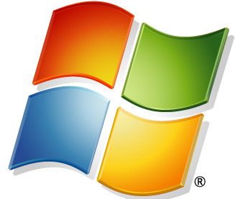

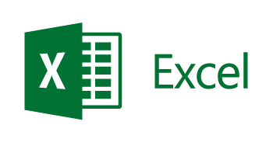

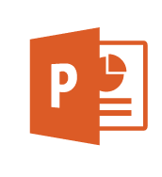
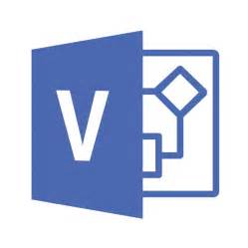


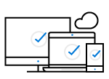
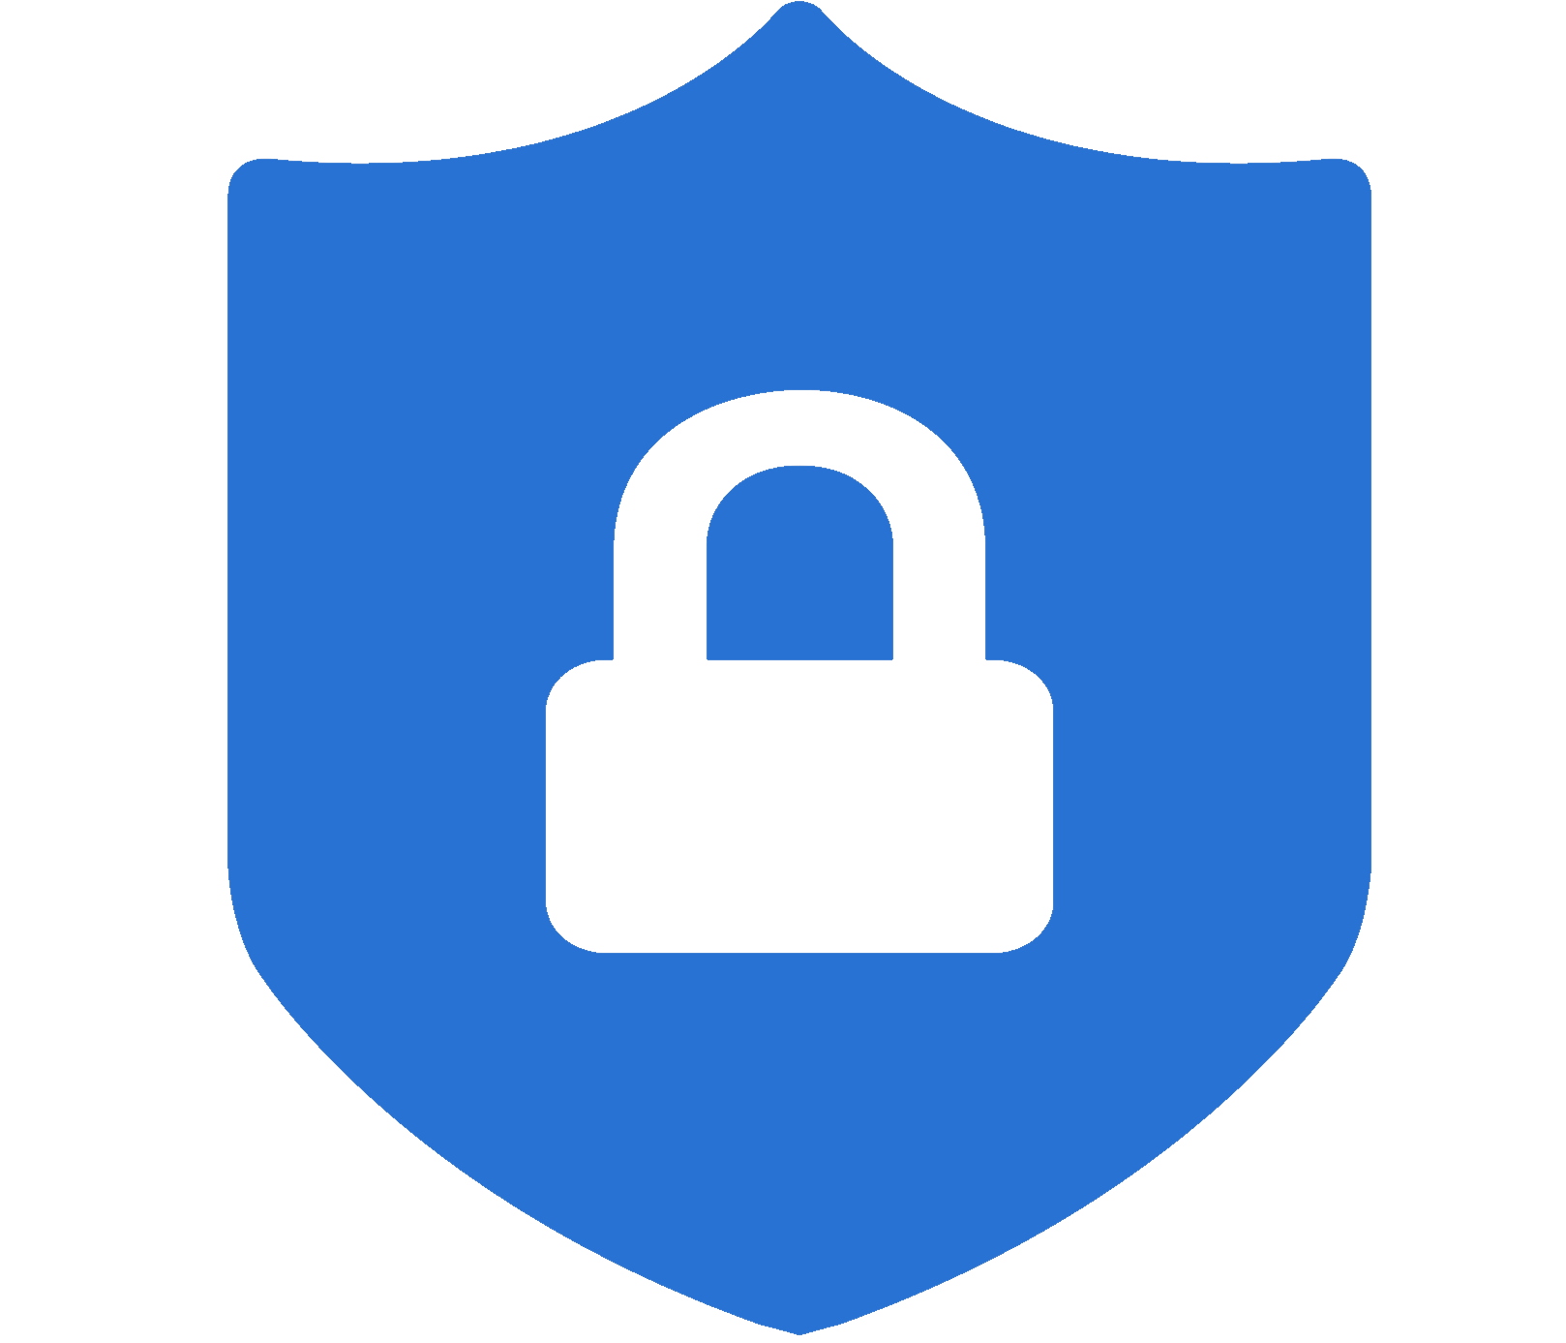



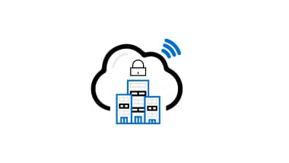

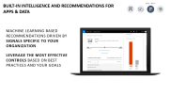
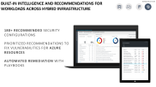
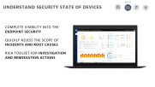
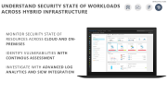
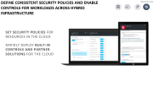
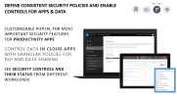
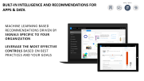
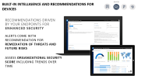
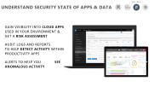

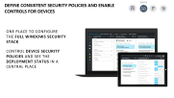
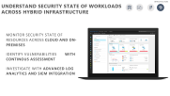





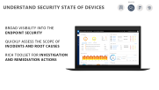
Visibility, Control, and Recommendations across your estate
Infrastructure
Apps and Data
Devices
On Premises & Other Clouds
Office 365
Microsoft Azure
Mobile & Unmanaged
Managed
IoT
Visibility
Monitor policy compliance across hybrid cloud infrastructure
Security Updates
Anti-malware signatures
Security Configuration
Enterprise Configuration Management
Discover 14,000+ SaaS apps, manage them
Sensitive document classification and tracking (anywhere on internet)
Trends on Tenant and Industry
Measure Device Health and Compliance
Managed, Compliant, (Not) Compromised)
Inventory & Manage IoT Devices
Enterprise Configuration Management
Control
Alert on policy violations
Automated vulnerability remediation in Azure (runbooks + native webhooks)
Single identity across SaaS + Intranet
Alert and take action on policy violations (e.g. quarantine overshared files)
Sensitive document encryption access revocation
Mobile Device & Application Management
Author policies, track deployment & state
Conditional Access to accounts/apps
Guidance
Recommended security configurations
Threat intelligence reports and mitigation guidance
Risk ratings on 16k+ SaaS applications
O365 Tailored Security Guidance and Prescriptive Recommendations
Tailored Security Guidance and Prescriptive Recommendations
IoT Reference Architecture with Threat Modelling, Security Maturity Model, and other Guidance
Notes:
Key takeaway: This is an illustration of the broad investments Microsoft has made into improving security management
Modern enterprises are managing risks on traditional on premises datacenters and PCs all the way to cloud datacenters, modern cloud applications, and unmanaged mobile devices.
Visibility –
Infra - Microsoft has invested heavily into Azure Security Center (ASC) to help solve longstanding issues with tracking your assets and key security hygiene issues like missing security updates, AV signatures, web app firewalls, and more
Apps and Data – Microsoft’s Cloud App Security helps discover and assess SaaS shadow IT risk, Azure Information Protection helps track sensitive documents, and Office 365 Threat Intelligence allows you to see malware trends on your O365 tenant and in your industry
Devices – in addition to traditional system management capabilities, Microsoft Intune allows you to measure the device health and compliance of your mobile devices (which can be also used in authentication decisions via Conditional Access)
Control –
Infra – ASC builds on the visibility to get you alerts on policy violations and the ability to remediate them (apply software updates, AV signature update, configuration baselines, Web App Firewalls, and more)
Apps and Data – Azure Active Directory + Active Directory allows you to have a unified identity spanning your on-premises estate and the vast new SaaS estate of 3rd party applications, Cloud App Security can alert on SaaS shadow IT risk and shut them down (such as quarantining sensitive files that are openly shared), and Azure Information Protection protects sensitive documents regardless of where they are (USB sticks, file sharing service, mobile devices, corporate PCs, etc.)
Devices – Intune allows you to manage mobile devices or mobile applications to protect the data on them (while preserving a productive user experience), Windows Security center allows you to manage a number of security aspects of Windows 10 devices, and Azure AD Conditional Access allows you to restrict access to accounts and applications based on device health, multi-factor authentication, authentication risk level, and other risk factors.
Guidance
Infra – ASC provides guidance on recommended security configurations as well as access to threat intelligence reports and guidance relevant to threats it detects
Apps and Data – Cloud App Security provides risk ratings for SaaS applications to help you make better judgements and policies on which applications to sanction or block (based on regulatory certification, industry standards, and best practices - More at https://docs.microsoft.com/en-us/cloud-app-security/risk-score).
Office 365 Secure Score gives you a tailored assessment of your tenant and guidance to address any open risks
Devices – Windows Security Center provides tailored guidance and prescriptive recommendations on your devices

Slide 23
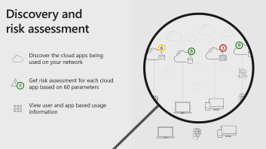
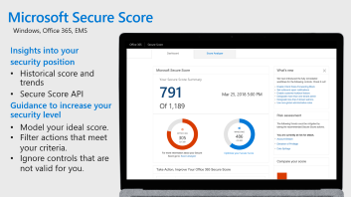
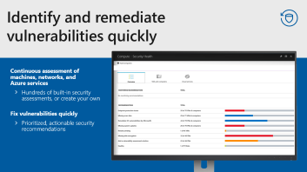

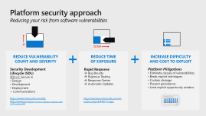



Vulnerability Management Investments Hitting refresh on traditional approaches
Software Vulnerabilities
Visibility and Measurement of Risk (Software + Configuration + Operations)
SEE MODULE 4A
Platform investments
Microsoft Secure Score
Recommendation Roadmaps
Configuration Manager
Intune
Lateral Movement Risk
Azure Security Center
SQL Vulnerability Assessment
Azure Update Management
Credential Scanner (Published Tenant Keys)
Security Updates
3rd Party SaaS Risk
Hybrid CLOUD INFRASTRUCTURE
Other Risks
Notes:
Key Takeaway: The nature of vulnerability management is evolving beyond just software patches
Microsoft is investing to help organizations effectively manage the next generation of vulnerabilities
Vulnerability management has been traditionally focused on scanning for missing software patches and applying them. This definition of a security vulnerability is no longer sufficient because
Attackers have become adept at exploiting vulnerabilities in the way systems are configured and operated (not just in how the software is designed or written)
Organizations have added software as a service (SaaS) from cloud services like Office 365, Azure, AWS, Google, and many others. This introduces many new integration points to secure and security often has limited visibility or control over SaaS selection processes and usage.
Microsoft has been investing in both reducing risk of traditional software vulnerabilities as well as providing visibility and control of these new risks.
These investments include:
Microsoft Secure Score - Provides insights into security status/gaps and next actions for your Windows hosts and Office 365 tenants.
https://docs.microsoft.com/en-us/windows/security/threat-protection/windows-defender-atp/secure-score-dashboard-windows-defender-advanced-threat-protection
SQL Vulnerability Assessment – Service that discovers, tracks, and helps you remediate potential database vulnerabilities.
https://docs.microsoft.com/en-us/azure/sql-database/sql-vulnerability-assessment
Lateral Movement Risk – Azure ATP provides insight into how attackers can gain control of sensitive accounts using credential theft and other techniques
https://docs.microsoft.com/en-us/azure-advanced-threat-protection/use-case-lateral-movement-path
3rd Party SaaS App Risks – Microsoft Cloud App Security provides insight into usage of and data stored on 3rd party cloud applications (sanctioned and Shadow IT) for visibility and control of risk
https://docs.microsoft.com/en-us/cloud-app-security/what-is-cloud-app-security
Credential Scanner – Scan your code to help avoid inadvertently publish secrets to open source repositories like GitHub (e.g. Storage access keys, API management keys, AAD Service principal keys, SQL connection strings, etc.)
https://blogs.msdn.microsoft.com/visualstudio/2017/11/17/managing-secrets-securely-in-the-cloud/
Software Vulnerabilities – Multiple capabilities including
System Center Configuration Manager https://docs.microsoft.com/en-us/sccm/sum/understand/software-updates-introduction
Intune https://docs.microsoft.com/en-us/intune/windows-update-for-business-configure
Azure Security Center - Monitors Windows and Linux virtual machines (VMs) and computers for missing operating system updates https://docs.microsoft.com/en-us/azure/security-center/security-center-apply-system-updates
Azure Security Update Management https://docs.microsoft.com/en-us/azure/automation/automation-update-management

Slide 24
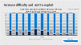
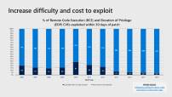
Platform security approach Reducing your risk from software vulnerabilities
#
time
REDUCE VULNERABILITY COUNT AND SEVERITY
REDUCE TIME OF EXPOSURE
INCREASE DIFFICULTY AND COST TO EXPLOIT
Security Development Lifecycle (SDL)
SD3+C: Secure in
Design
Development
Deployment
+ Communications
Rapid Response
Bug Bounty
Rigorous Testing
Response Center
Automatic Updates
Platform Mitigations
Eliminate classes of vulnerabilities
Break exploit techniques
Contain damage
Prevent persistence
Limit exploit opportunity window
https://www.microsoft.com/SDL
http://www.iso.org/iso/home/store/catalogue_tc/catalogue_detail.htm?csnumber=44378
https://technet.microsoft.com/en-us/security/dn440717.aspx
Notes:
Key Takeaway: Over the last 15+ years, Microsoft has been systematically reducing customer risk through platform security improvements.
The first priority we tackled was to reduce the number and severity of security vulnerabilities in our products, which we accomplished by creating a security development lifecycle (SDL). We have published our SDL openly (including many tools we use internally) and it became the basis of the ISO standard on secure software development.
CLICK 1
Another top priority is to reduce the amount of time that any vulnerability would be exposed. We pioneered regular automatic updates (known to many as “Patch Tuesday”), created a dedicated security response center (MSRC) to rapidly respond to reported issues, rigorously test security updates prior to release, and have also adopted a bug bounty program to reduce the incentive of security researchers selling security vulnerabilities on the grey or black markets.
CLICK 2
We have also been continuing to work hard to reduce the opportunity of attackers to exploit vulnerabilities by investing in platform mitigations to eliminate entire classes of vulnerabilities, break exploit techniques, and architect the platform to contain damage and prevent malware persistence.
Additional Commentary
Rigorous Testing - From https://blogs.microsoft.com/microsoftsecure/2017/06/08/the-ciso-perspective-putting-lessons-from-wannacrypt-into-practice-to-avoid-future-threats/
“…the Windows team works hard to ensure that they consistently deliver high quality updates that can be trusted by hundreds of millions of users. They conduct thousands of manual and automated tests that cover the core Windows functionality, the most popular and critical applications used by our customers, and the APIs used by our broad ecosystem of Windows apps and developers. The team also reasons over the data, problem and usage reports received from hundreds of millions of devices and triages that real world usage information to proactively understand and fix application compatibility issues as quickly as possible. With all of this context in mind, I want to acknowledge that even more work is needed to make updates easier to deploy and we have teams across the company hard at work improving the experience.”

Slide 25
Increase difficulty and cost to exploit
FROM BLOG:
Mitigating arbitrary native code execution in Microsoft Edge
Notes:
Key Takeaway: These numbers illustrate some of the progress we have made to increase the difficulty and cost of exploitation for attackers.
Many attackers reverse engineer the software updates we release to identify the vulnerability that was fixed so that they can exploit it quickly before organizations have a chance to deploy the updates.
This graph shows how our platform mitigations investments have resulted in an overall decrease in the successful exploitation of vulnerabilities. See the blog link for additional details.

Slide 26
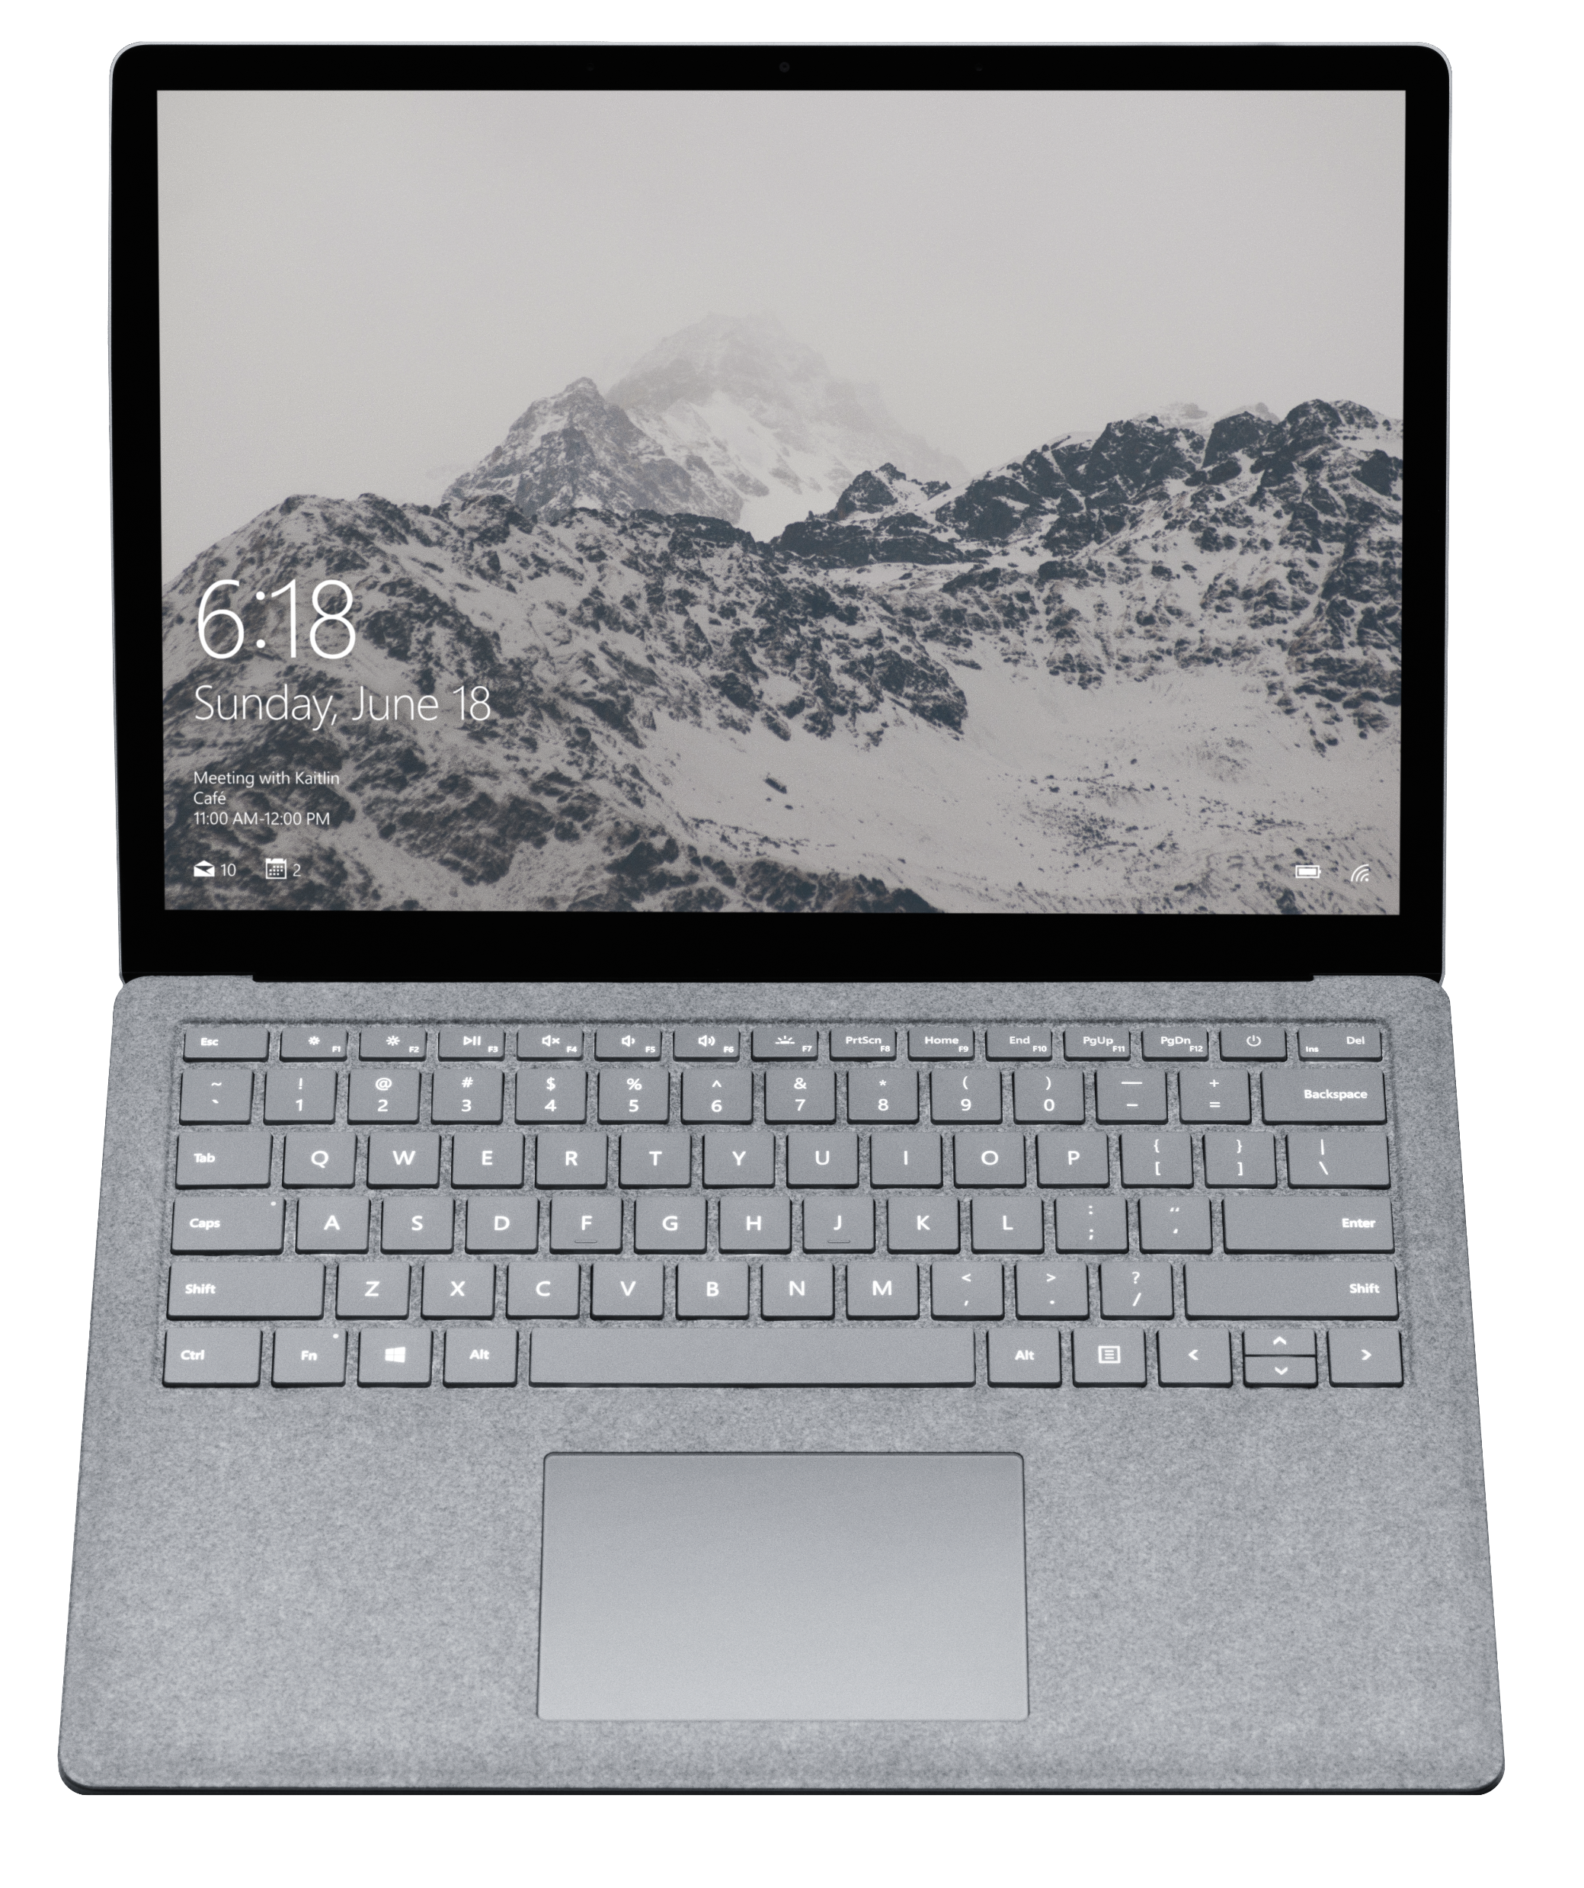
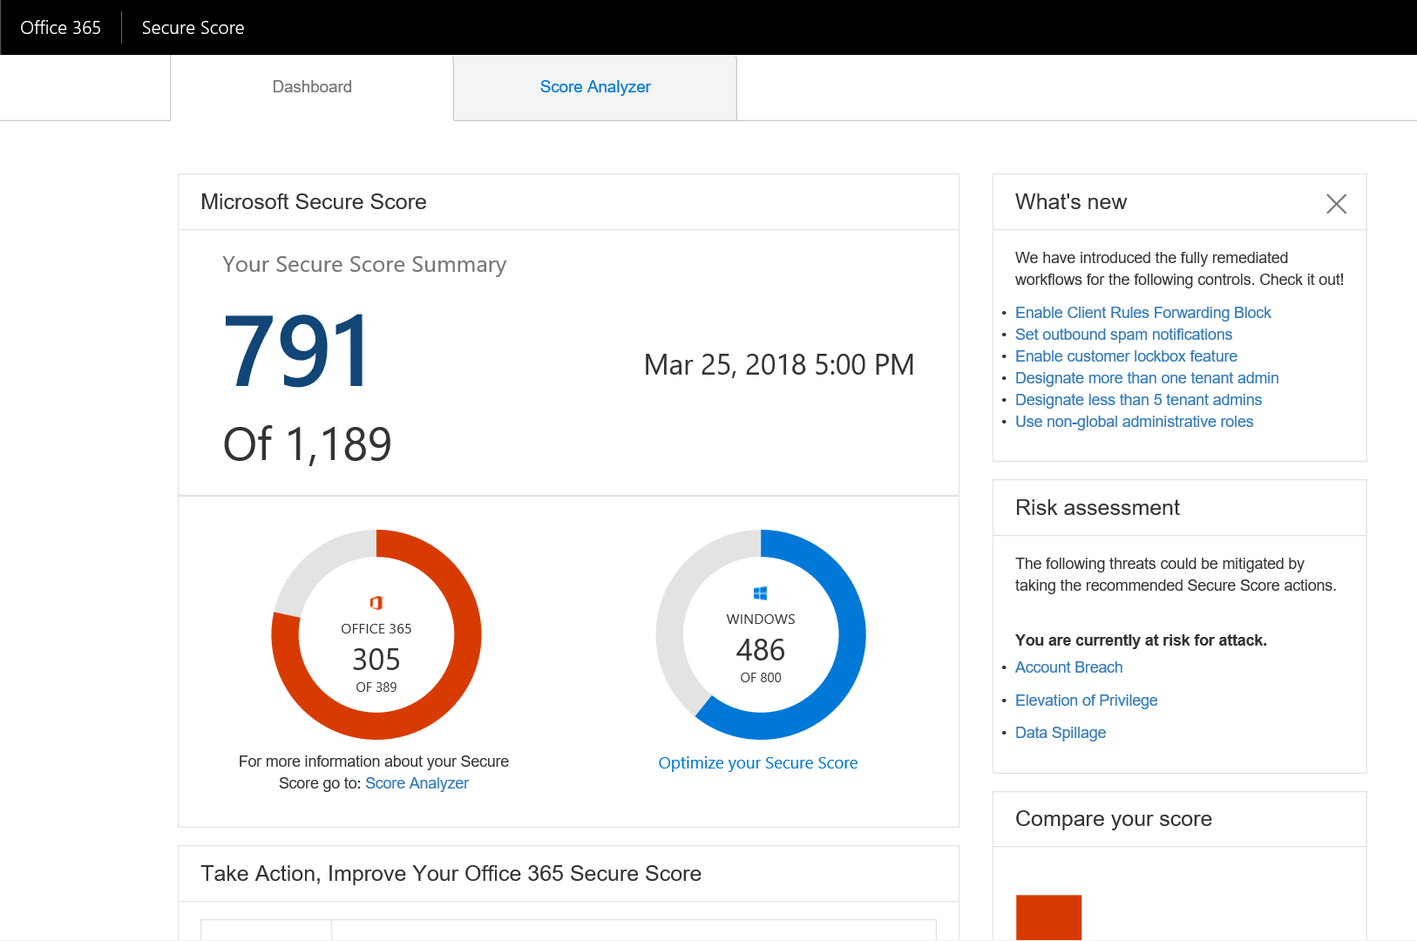
Microsoft Secure Score
Windows, Office 365, and more
Insights into your
security position
Historical score and trends
Secure Score API
Guidance to increase your security level
Model your ideal score.
Filter actions that meet your criteria.
Ignore controls that are not valid for you.
Notes:
Key Takeaway: Microsoft Secure Score provides insight into your current security state, how you compare to others, and helps you plan security posture improvements
Secure Score has been available since early 2017 and was originally built for Office 365. Hence you will see many controls for Office 365 in the service. However, we have recently added support for showing your total Windows score based on the data found in Windows Defender ATP. If you want to dive deeper into your Windows score you can click on the score and it will take you to the Windows Defender ATP console where you can investigate which controls, you can use to improve your score.

Slide 27
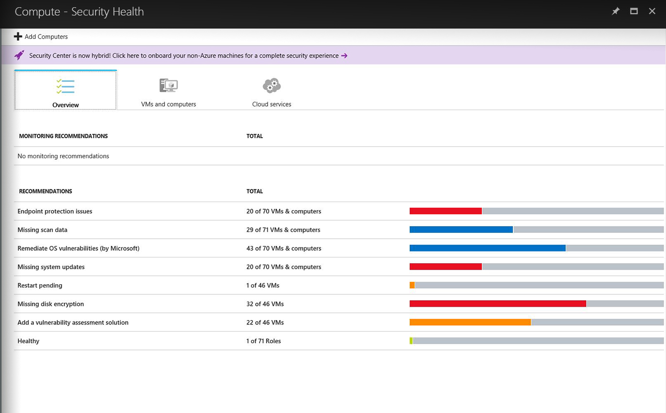
Identify and remediate vulnerabilities quickly
Continuous assessment of machines, networks, and Azure services
Hundreds of built-in security assessments, or create your own
Fix vulnerabilities quickly
Prioritized, actionable security recommendations
Notes:
Key Takeaway: Azure Security Center provides insight into your security posture of Azure resources
For more information, see https://docs.microsoft.com/en-us/azure/security-center/

Slide 28
Discovery and risk assessment
6
3
9
8
Discover the cloud apps being used on your network
Get risk assessment for each cloud app based on 60 parameters
8
View user and app based usage information
Notes:
Key Takeaway: Microsoft Cloud App Security provides security insight into the SaaS applications used by your enterprise and helps you manage that risk
For more information, see https://docs.microsoft.com/en-us/cloud-app-security/what-is-cloud-app-security

Slide 29
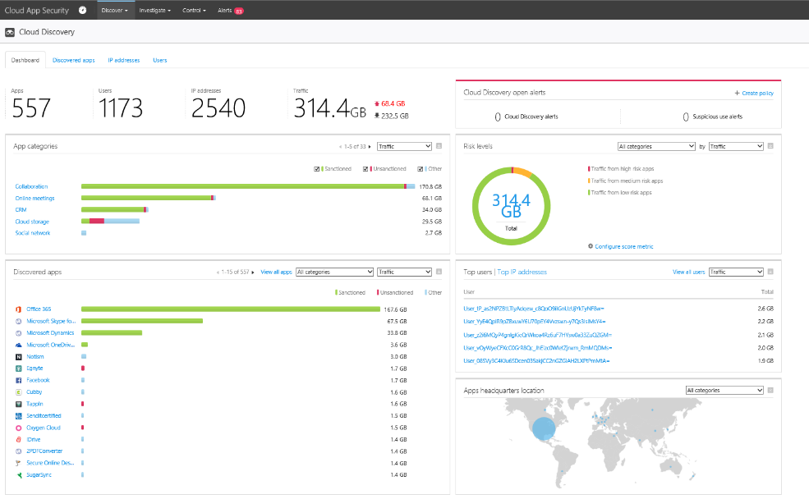
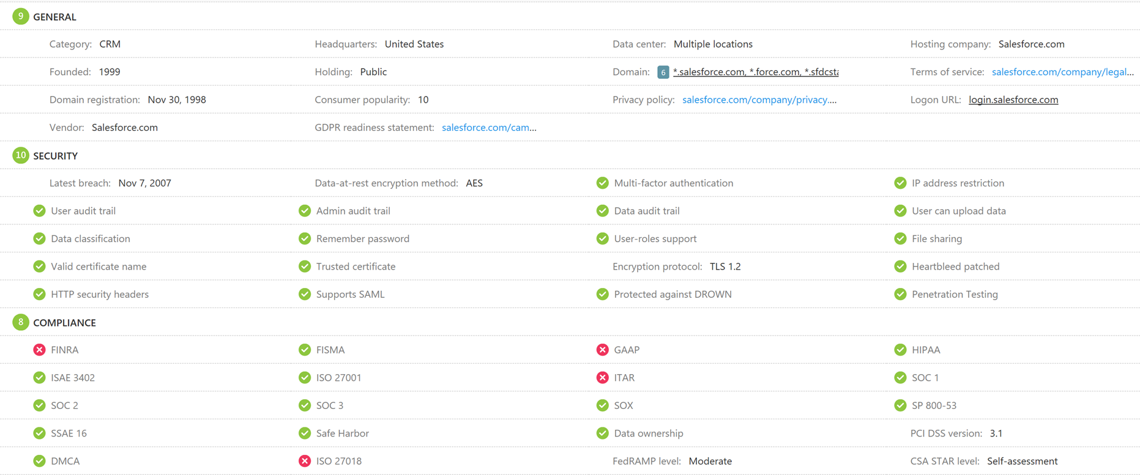
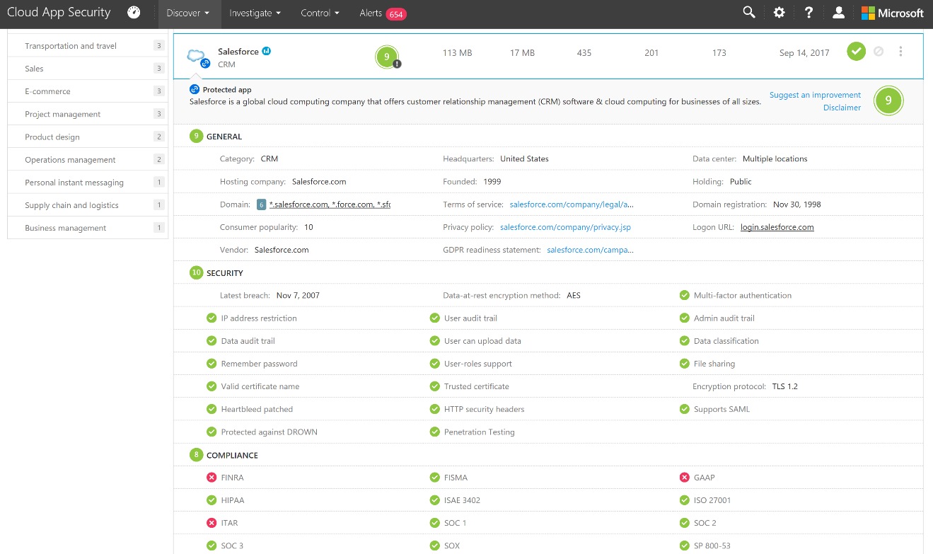
Discovery and risk assessment
Discovery of cloud apps and data
Discover 15K+ cloud apps in use across your networks and sensitive data they store.
Cloud app risk assessment
Assess cloud app risk based on ~60 security and compliance risk factors.
On-going analytics
Get anomalous usage alerts, new app and trending apps alerts.
Log anonymization
Protect your employees’ privacy while discovering cloud apps in your environment.
Advanced incident investigation tools
Investigate on users, file, activities, locations and managed apps, quantify exposure and risk.
Notes:
Key Takeaway: This is an example of Microsoft Cloud App Security report on a SaaS provider

Slide 30
Security Transformation Consider a program of change including strategy, planning, execution, and governance
Common challenges:​
… network security is regularly bypassed with phishing and credential theft
… SIEMs and other tools overload analysts more than empowering them
… overwhelming security hygiene requirements for devices, identity, applications, etc.
… data is everywhere and constantly at risk
Imagine a future where: ​
… your identities cannot be stolen
… untrusted software cannot run
… and users can click fearlessly (and safely)
… data is automatically classified and protected wherever it goes
Align with Business Leaders
Digital transformation is challenging for business leaders to navigate and security can partner to help them manage risk while enabling productivity
Services to Accelerate Transformation
Microsoft Enterprise Cybersecurity Advisory Service (ECAS) can help accelerate security’s digital transformation by helping create a cybersecurity program of change. http://aka.ms/ECAS-Datasheet
Notes:
Key Takeaway: We recommend that security organizations consider a program to manage the changes required to manage the dual challenges of changing platforms + rapid threat evolution

Slide 31
Questions?

Slide 33
References

Slide 34
Common attack steps and mitigations
Office 365 Advanced Threat Protection (ATP) (requires E5)
Securing Privileged Access Roadmap
Professional Services
Incident Response
Security Foundation (Major Breach Protections)
Credential Guard
Advanced Threat Analytics (in EMS E3)
Azure Security Center
…and more
2a
Credential Theft and Abuse
Gathers credentials stolen credentials to move laterally
1
Phishing Email
Threat Actor targets employee(s) via phishing campaign
→
Increase access to your environment
3
Access Data
Threat Actors exfiltrate PII and other sensitive business data
→ Access same data as employee
2
Compromise Device/Account
Employee opens attachment/link or types credentials into fake web page
EMS Technology
Azure Information Protection (requires E5)
Cloud App Security (CASB) (requires E5)
Office 365 Data Loss Prevention features
Windows Information Protection
Azure Technology
Multi-Factor Authentication
Azure Identity Protection
Disk, Storage, SQL Encryption
Key Vault
…
EMS Technology
Intune conditional access
Windows 10 Technology
Device Guard
Application Guard
Defender Advanced Threat Protection (requires E5)
SmartScreen URL and App reputation

Slide 35




PLAN
ENTER
TRAVERSE
EXECUTE MISSION
A. Enter and Navigate
2a
Workstation compromised, threat actor gathers credentials
Threat Actors use stolen credentials to move laterally
3a
Published Guidance
Securing Privileged Access Roadmap
Professional Services
Security Foundation
Enhanced Security Admin Environment (ESAE)
Technology
Advanced Threat Analytics (in EMS E3)
Azure Security Center
…and more
Any employee opens attack email
→ Access to most/all corporate data
Any
Windows 10 Technology
Device Guard
Credential Guard
Defender Advanced Threat Protection (requires E5)
Office 365 Technology
Advanced Threat Protection (requires E5)
Common Attacks
4
Threat Actors exfiltrate PII and other sensitive business data
1
Threat Actor targets employee(s)
via phishing campaign
EMS Technology
Azure Information Protection (requires E5)
Office 365 Technology
Data Loss Prevention
Windows 10 Technology
Windows Information Protection
Azure Technology
Disk, Storage, SQL Encryption
Key Vault
…
Employee B opens infected email (Mobile or PC). Attacker disables antivirus
Compromised credentials/ device used to access cloud service / enterprise environment
B. Device Compromise
2b
3bc
Targeted employee opens attack email
→ Access to same data as employee
EMS Technology
Intune conditional access
EMS Technology
Cloud App Security (CASB) (requires E5)
Office 365 Technology
Advanced Security Management (basic CASB) (requires E5)
Azure Technology
Multi-Factor Authentication
Azure Identity Protection
Credentials harvested when employee logs into fake website
Remote Credential Harvesting
2c
Microsoft Incident Response Teams can be engaged to investigate any incident type as well as to assess your organization for existing compromises
Targeted employee(s) enter credentials in website
→ Access to same data as employee(s)
Windows 10 Technology
SmartScreen URL and App reputation
Application Guard

Slide 36


Integrating with your SIEM Two different approaches to connect to your existing SIEM tool and processes
1. Graph Security API
SIEM Integration - https://docs.microsoft.com/en-us/graph/security-siemintegration
Solutions already Integrated - https://docs.microsoft.com/en-us/graph/api/resources/security-api-overview?view=graph-rest-1.0
2. Individual Capabilities
Windows Defender ATP
https://docs.microsoft.com/en-us/windows/security/threat-protection/windows-defender-atp/enable-siem-integration-windows-defender-advanced-threat-protection
Azure Advanced Threat Protection
https://docs.microsoft.com/en-us/azure-advanced-threat-protection/cef-format-sa
Office 365
https://docs.microsoft.com/en-us/office365/securitycompliance/siem-server-integration
https://docs.microsoft.com/en-us/office365/securitycompliance/siem-integration-with-office-365-ti
Cloud App Security
https://docs.microsoft.com/en-us/cloud-app-security/siem
Azure SIEM Integration (includes Azure AD)
https://docs.microsoft.com/en-us/azure/azure-monitor/overview
Notes:
Key Slide Takeaway: Microsoft recognizes that many security organizations need SIEM integration and offers integration capabilities

Slide 37

VISIBILITY
Understand the security state and risks across resources
Notes:
There are 3 security management imperatives; visibility, control and guidance.
Now let’s take a closer look at what Microsoft can provide your organization when it comes to VISIBILITY into your security state and risks.

Slide 38

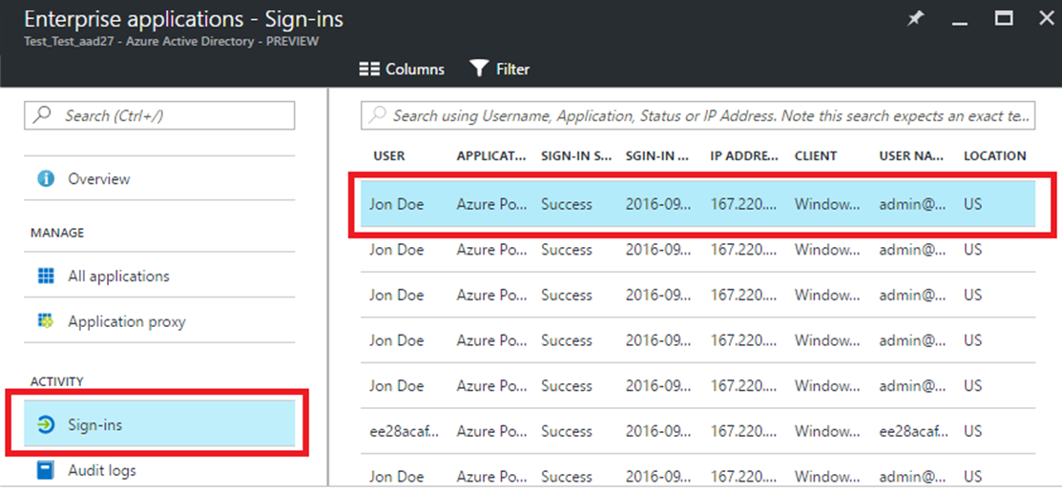


IDENTITY
UNDERSTAND SECURITY STATE OF USERS
gain visibility into the security of your directory with access and USAGE REPORTS IN Azure AD
Discover privileged accounts in your environment with azure ad privileged identity management
Azure Active Directory
Notes:
VISBILITY FOR IDENTITY
Key Takeaway: Microsoft’s Identity and Access Management service, Azure Active Directory provides access, usage, and security reports to gain visibility into the integrity and security of your organization’s directory.
With this information, a directory administrator can better determine where possible security risks may lie so that they can adequately plan to mitigate those risks.
With Azure Active Directory You can analyse;
- User-specific reports that display device and sign in activity data for a specific user.
- Or review Activity logs that contain a record of all audited events within the last 24 hours, last 7 days, or last 30 days, as well as group activity changes, and password reset and registration activity.
In addition, Azure AD provides deep visibility into privileged identities to help you manage privileged accounts and monitor their activities because of the risk associated with their misuse including malicious or rogue administrators. These credential thefts can undermine compliance with the GDPR.
Azure AD Privileged Identity Management can help you discover these types of malicious administrator roles and the user accounts they are assigned to. It will also enable you to revoke permanent privileged access and provide a mechanism that manages on-demand, time-limited access for Azure Active Directory privileged accounts. So, you get the ability to discover, restrict and monitor administrators and their access to resources. Users that need administrative access can get it for a preconfigured limited time (with just-in-time access) after they have proved their identity with Multi-Factor Authentication.

Slide 39

DEVICES
UNDERSTAND SECURITY STATE OF DEVICES
Broad visibility into the endpoint security
Quickly assess the scope of incidents and root causes
Rich toolset for investigation and remediation actions
Notes:
VISIBILITY FOR DEVICES
Key Takeaway: The next release of Windows Defender Advanced Threat Protection (or ATP) will include Windows security analytics, which provides both your Security Management and Security Operations teams with visibility into the security state of their endpoints and enables them to proactively address configuration issues to reduce the attack surfaces.
Windows security analytics gives full visibility into your devices’ security posture without the need to manually gather different reports from IT teams. Its powerful analytics capabilities enable you to understand how well your current device security posture is and how it compares to industry peers.
The Windows security analytics dashboard provides you with your:
- Organizational Security score
- Security score trends over time
- Security coverage - list of supported Windows security controls.
- Improvement opportunities – provides recommended actions for each security control with the indication of potential security score improvement. We will get to this a little later.
Overall it gives them a detailed view of their security control configuration, considering available settings and how up to date they are in terms of Windows security patches.

Slide 40


APPS / DATA
UNDERSTAND SECURITY STATE OF APPS & DATA
GAIN VISIBILITY INTO CLOUD APPS USED IN YOUR ENVIRONMENT & get a risk assessment
Audit logs and reports to help detect activity Within Productivity apps
Alerts to help you see anomalous activity
Notes:
VISIBILITY FOR APPS & DATA
Key Takeaway: For your apps and data, Office 365 includes access to audit logs. This helps you understand what your users are doing within the service to aid in any investigations you have.
The log can be easily accessed and searched via the Security and Compliance Center and holds data for up to 90 days. For organizations that need to retain data for longer than 90 days, we make much of the data available through the Management Activity API which can be consumed by many SIEM solutions.
To help you visualize the data in the logs, Office 365 also includes built in reports for many of the security features. This way you can easily see events like how many people are violating DLP polices across SharePoint Online, One Drive for Business, and Exchange Online, or how much malicious attachments are being stopped by Office 365 Advanced Threat Protection.
While reports and the audit logs are great, organizations tell us that they don’t have enough knowledge or the staff to stay on top of what their users are doing within Office 365. With a large Office 365 tenant creating over a million audit events a day, we understand that could be a challenge.
To help with this, we created Office 365 Advanced Security Management (or ASM). ASM helps you get additional visibility and control into your tenant by parsing the data from the Management Activity API and creating alerts on anomalous activity such as someone logging in from a new location, failing to login more then they normally do, or is using an ISP that they normally don’t use.
These alerts can also be on specific activities that you care about such as uploading or syncing files to OneDrive with known ransomware extensions, or downloading a large amount of content from a SharePoint site that has sensitive HR data.

Slide 41

INFRASTRUCTURE
UNDERSTAND SECURITY STATE OF WORKLOADS ACROSS HYBRID INFRASTRUCTURE
Monitor security state of resources across cloud and on-premises
Identify vulnerabilities WITH CONTINOUS ASSESSMENT
INVESTIGATE with Advanced log analytics and SIEM integration
Notes:
VISIBILITY FOR INFRASTRUCTURE
Key Takeaway: Managing security across increasingly distributed infrastructure is complex and can create gaps that are frequently exploited by attackers. Azure Security Center or ASC is a built-in service to Azure that enables you to monitor and assess the security state of your Azure workloads continuously.
ASC helps you gain visibility into machines with missing security updates, insecure OS configurations, or insufficient malware protection, as well as vulnerable Azure virtual network, storage, database, and application configurations. With prioritized recommendations, you can quickly mitigate any vulnerabilities and drive compliance.
Azure Security Center is built on the Log Analytics infrastructure and can also be used to collect and analyze security data, but it takes a more modern approach to enabling Security Operations. Azure Security Center harnesses the power of the cloud to reduce operational costs and improve the effectiveness of security management, threat detection, and incident response.

Slide 42

Control
Define consistent security policies and enable controls
Notes:
Key Takeaway: Defining consistent security policies and enabling controls are crucial to intelligent security management.

Slide 43

Define consistent security policies and enable controls FOR USERS
IDENTITY
Use conditional access to protect your organization at the front door
Control and protect privileged identities
Notes:
CONTROL FOR IDENTITY
Key Takeaway: Azure Active Directory, Microsoft’s Identity and Access Management solution, is designed to help organizations manage user identities and associated access privileges.
With capabilities, such as conditional access, user and sign-in risk calculation, multi-factor authentication and privileged identity management, Azure Active Directory can help you secure and restrict access to data.
Azure AD Conditional Access provides a powerful framework for regulating access in governance, risk, and compliance scenarios. Conditional Access policies can be applied based on device state, application sensitivity, location and user rules. Additionally, Microsoft Enterprise Mobility + Security can protect your data in real-time from the most advanced threats with identity protection capabilities that calculate the risk of every access request and every user and apply automated remediation actions as needed.
Additionally, the risk calculation by Identity Protection is based on a set of signals we collect from across our products, global cloud services and cybersecurity teams and from other non-Microsoft sources.
While any compromised account is bad, a compromised admin account frequently has major business impacts. It’s critical to minimize the probability and number of accounts with admin privileges. Azure AD Privileged Identity Management gives you a capabilities to move to a “no standing privilege” model with the smallest possible number of admin-privileged users. It helps you set up policies to grant admin access only when needed, on for as long as needed, and only in compliance with your elevation policies.

Slide 44

Define consistent security policies and enable controls FOR DEVICES
DEVICES
One place to configure the full Windows Security stack
Control device security policies and see the deployment status in a central place
Notes:
CONTROL FOR DEVICES
Key Takeaway: The ability to quickly enable the full Windows Security stack and configuring it in a way that is compliant with your security policies is one of the most important security management practices.
Microsoft now provides a centralized location to give you control over enabling and configuring your Windows Security features.
Security Administrators will use System Center Configuration Manager or Microsoft Intune as their single unified IT management tool. With it they can configure all the Windows security controls in one place. It is also very effective for organizations that use role based security to make sure the right people have the right access and control.
You can simply use your existing Microsoft Intune or System Center Configuration Management infrastructure to manage the full Windows Security stack.

Slide 45




Define consistent security policies and enable controls FOR APPS & DATA
APPS / DATA
Customizable portal for most important security features for productivity apps
CONTROL DATA IN CLOUD APPS WITH GRANULAR POLICIES FOR dlp AND DATA SHARING
See security controls and their status from different workloads
Notes:
CONTROL FOR APPS & DATA
Key Takeaway: To help you have better control over your security posture with your apps and data, Office 365 includes a core set of tools. The Security and Compliance Center is a customizable, centralized portal for the most important security and compliance features.
Here you can easily setup DLP and data retention policies, configure how malware and spam are handled, and review threat intelligence data on your tenant. Its home page allows you to setup widgets to help you track the things that are important to you.
The Security and Compliance Center also makes it easy to configure role based security groups, giving people access to just the security and compliance features they need versus granting them global admin rights, which gives them access to other administrative functions like billing, assigning licenses, or creating new users.
Office 365 also provides Secure Score, a security analytics tool that makes finding and enabling some of the core security controls easier – Such as enabling multifactor authentication, auditing, and security features from the various Office workloads like SharePoint Online, One Drive for Business and Exchange Online. Along with providing a single number to represent how you are reducing your security risk, Secure Score also keeps historical data of what controls you enabled, so you can track and share your progress/score with other members of your organization.

Slide 46


Define consistent security policies and enable controls FOR WORKLOADS ACROSS HYBRID INFRASTRUCTURE
INFRASTRUCTURE
Set security policies for resources In THE CLOUD
Rapidly deploy built-in controls and partner solutions for THE CLOUD
Notes:
CONTROL FOR INFRASTRUCTURE
Key Takeaway: Azure Security Center will enable you to define policies for set of controls, which are recommended for resources within the specified subscription. You can define policies according to your company's security requirements and the type of applications or sensitivity of the data.
Security Center also helps you to enable built-in security controls for resources, so you can easily turn on protections including anti-malware, network security groups or web application firewall. It also lets you deploy integrated partner solutions from the same console enabling additional layer of security.

Slide 47

Guidance
Enhance security through built-in intelligence and recommendations
Notes:
Key Takeaway: After you gain visibility into your security state and have controls in place, there is still continuous improvement and operations work to be done.
Security Management solutions from Microsoft can help you enhance your organization’s security through built-in INTELLIGENCE AND RECOMMENDATIONS.

Slide 48


BUILT-IN INTELLIGENCE AND RECOMMENDATIONS FOR USERS
IDENTITY
Take advantage of advanced security reports, remediation recommendations and risk-based policies to protect access in your organization
Notes:
GUIDANCE FOR IDENTITY
Key Takeaway: With Azure Active Directory, you protect your organization right at the front door and be the first line of defense with risk-based conditional access. Azure AD reports are the watchmen in the tower.
Azure AD provides Security reports in three broad categories:
1. Cases where a login is anomalous and associated with some level of risk that the login is an attempt at unauthorized access.
2. Cases with significant indication that a user’s credentials have been compromised, because they are showing up frequently in risky logins, or because we have discovered them in criminal hands.
3. Cases where your security posture could be improved, meaning there are vulnerabilities in your defenses that configuration changes can mitigate.
Azure AD Identity Protection Security Reports provide you all of this information, either in the Azure AD Portal or programmatically (so you can integrate it into your SIEM or ticketing system). Furthermore, you can take advantage of remediation actions and risk-based policies to protect access and be that first line of defense.

Slide 49


BUILT-IN INTELLIGENCE AND RECOMMENDATIONS FOR DEVICES
DEVICES
Recommendations driven by your endpoints FOR ENHANCED SECURITY
alerts come with recommendation for remediation of threats and future risks
Assess organizational security score including trends over time
Notes:
GUIDANCE FOR DEVICES
Key Takeaway: For Windows device security recommendations, Windows Security Analytics can help you with its dashboard that includes “Improvement opportunities.”
With all its configured controls and a score next to it, Windows Security Analytics provides recommended actions for each Windows security control.
You can see the potential security score improvement, by simply clicking on one of the controls. It also lists all available configurations for each control and shows which ones are applied to how many machines. The number next to each configuration shows how much the configuration change would contribute to that security score.
Windows Security Analytics provides your Security teams the information they need to have better insight into what security controls are available and which configurations can help you achieve a better security posture.

Slide 50

BUILT-IN INTELLIGENCE AND RECOMMENDATIONS FOR APPS & DATA
APPS / DATA
Machine learning based recommendations driven by signals specific to your organization
Leverage the most effective controls based on best practices and your goals
Notes:
GUIDANCE FOR APPS & DATA
Key Takeaway: When it comes to recommendations, Office 365 has a few ways to help you harden your security posture.
The first is Security and Compliance Center. The home page includes a widget that helps you see what recommendations the service has for your organization. Leveraging machine learning, Office 365 interprets signals from your usage of the service and data you provide, to help you better protect the information in your tenant. For example, the service can understand that you are not protecting tax documents and recommend that you create a data retention policy that will hold that content for 7 years. It can also understand that you don’t have a data loss prevention policy for PII data and help you easily create one. The service can even leverage information around what industry you are in to provide more customized recommendations.
We also want to help you leverage the most effective controls that help you balance productivity and security though Secure Score. Based on our best practices and data we have from customer support calls, we can provide a set of recommendations on what security controls you should enable to better protect your tenant from threats like data exfiltration, account breach, and elevation of privilege. Using the modeler, you can determine the target score you want to get to and then use filters to help you see controls based on categories like what the control protects (devices, data, and accounts), the user impact, and the implementation costs.

Slide 51


BUILT-IN INTELLIGENCE AND RECOMMENDATIONS FOR WORKLOADS ACROSS HYBRID INFRASTRUCTURE
INFRASTRUCTURE
180+ recommended security configurations
Prioritized recommendations to fix vulnerabilities for Azure resources
Automated remediation with playbooks
Notes:
GUIDANCE FOR INFRASTRUCTURE
Key Takeaway: Harnessing the power of machine learning, Azure Security Center is able to provide you with guidance and recommendations that will help you strengthen the security posture of your infrastructure.
To ensure your servers and VMs are secure and fully hardened, we provide recommended security baselines for different roles. These are sets of registry keys, audit policy settings, and security policy settings along with Microsoft’s recommended values for these settings. These will help you assess and drive compliance in your environment quickly.
When Azure Security Center identifies potential security vulnerabilities, it creates recommendations that guide you through the process of configuring the needed controls.
To assist security operations teams investigate and remediate threats quickly, Azure Security Center also includes investigation tools and threat intelligence reports that contain information about the threat that was detected including many details. These details include attacker’s identity or associations, objectives, current and historical attack campaigns and tactics, tools and procedures. It also includes remediation and mitigation guidance.
With Azure Automation and Logic Apps, you can also automate common remediation steps.

